Slide 1
Global Electric Vehicle Sales Data
(2010-2024)
Mohammed sabith

Slide 2
Introduction
Electric vehicles (EVs) have rapidly evolved from early innovations to become a key component of the transportation industry. This document traces the history of EVs, their technological advancements, and the different types of EVs available today. Through data visualizations and analysis, it highlights global EV trends, the growth in sales, and the distribution of powertrain types across regions. The resurgence of EVs underscores their potential to transform transportation and contribute to a more sustainable future.

Slide 3
Data Overview
Origins: Electric vehicles have their roots in the early 19th century. The first practical electric vehicle was built by Scottish inventor Robert Anderson between 1832 and 1839. This early electric carriage was powered by non-rechargeable batteries and laid the groundwork for future developments.

Slide 4
Decline: The decline of electric vehicles began with the rise of petrol-powered cars, facilitated by innovations such as the electric starter and mass production techniques introduced by Henry Ford. By the 1920s, the market for electric vehicles had diminished significantly as internal combustion engines became more widespread and infrastructure for petrol vehicles expanded.

Slide 5
Oil Crisis
The oil crises of the 1970s, particularly the 1973 Arab Oil Embargo and the 1979 energy crisis, sparked renewed interest in electric vehicles as alternatives to reduce reliance on fossil fuels and enhance energy security. The surge in oil prices emphasized the need for less oil-dependent transportation solutions.
Various automotive manufacturers and research institutions explored electric vehicles during this time. Despite the enthusiasm, many early attempts were constrained by the technology of the era, including limitations in battery performance and range. make it short

Slide 6
Overview: The Sinclair C5, designed by Sir Clive Sinclair, was an electric vehicle launched in 1985. It was a small, three-wheeled vehicle intended for short trips and urban commuting. The C5 had a top speed of about 15 miles per hour and a range of 20-30 miles on a single charge.

Slide 7
Methodology
Data Import and Preprocessing
Data Import and Preprocessing
Data Visualization
Data Analysis
Advanced Visualization
Final Outputs

Slide 8
Implementation
Library Imports
File Upload
Data Loading
Column Categorization Function
Data Visualization
Additional Data Visualizations

Slide 9
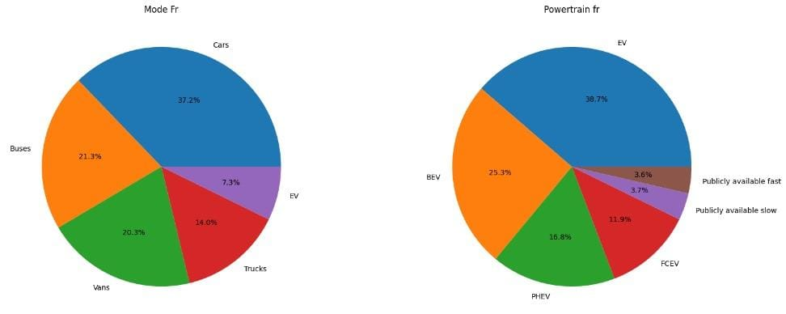
Results

Slide 10
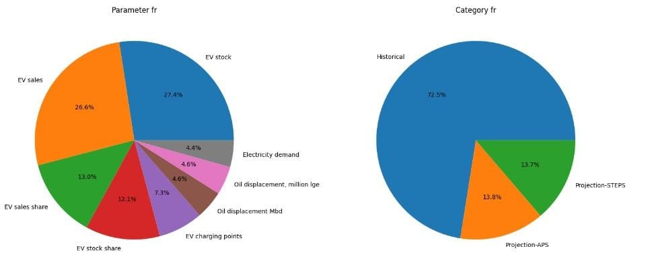

Slide 11
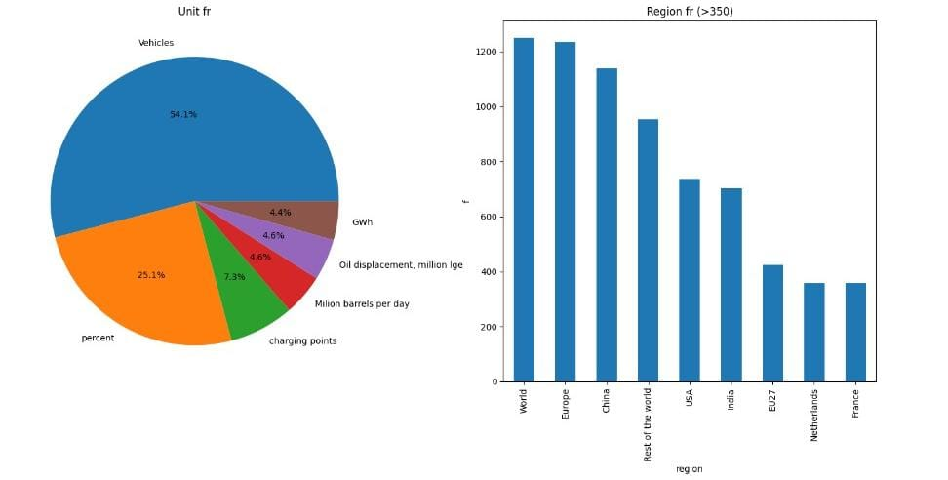

Slide 12
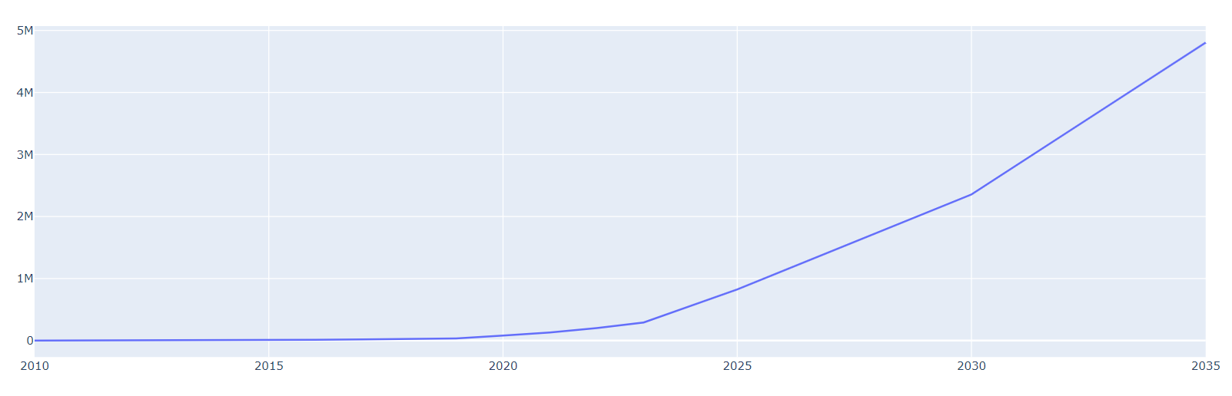
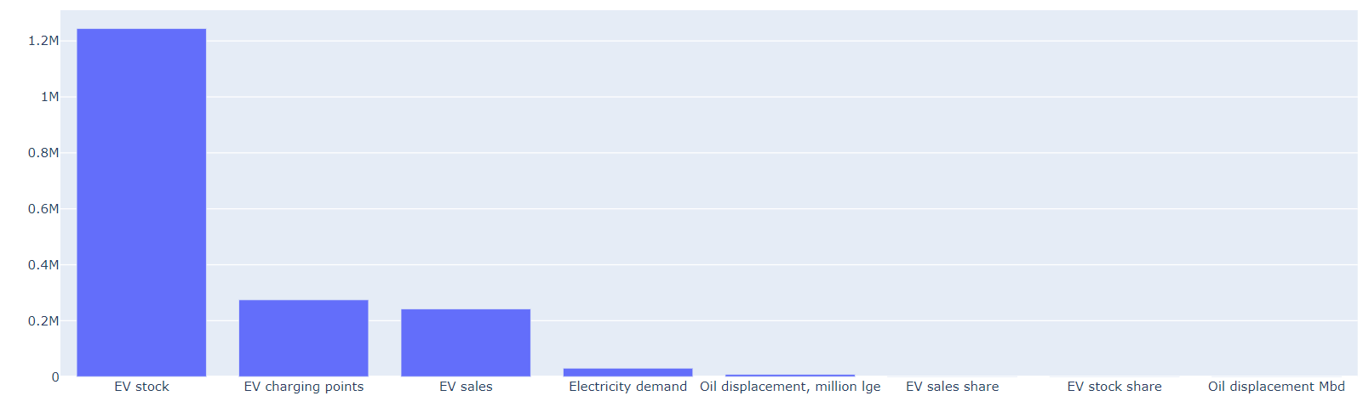

Slide 13
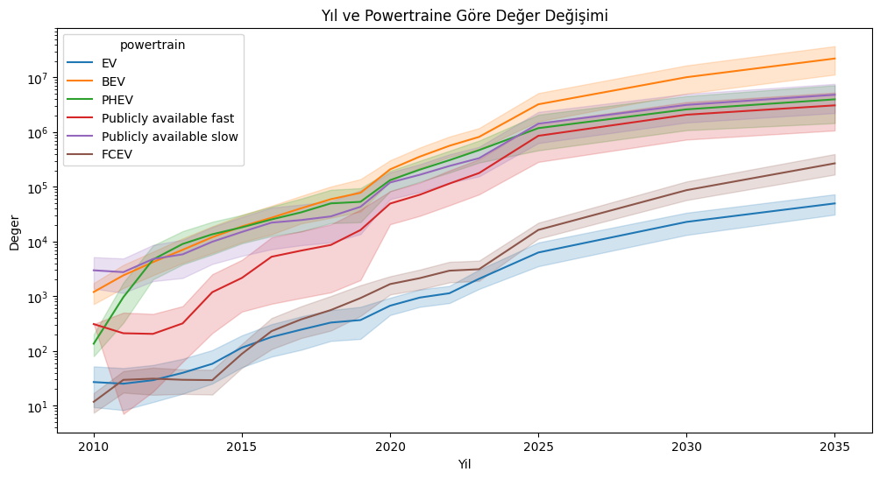

Slide 14
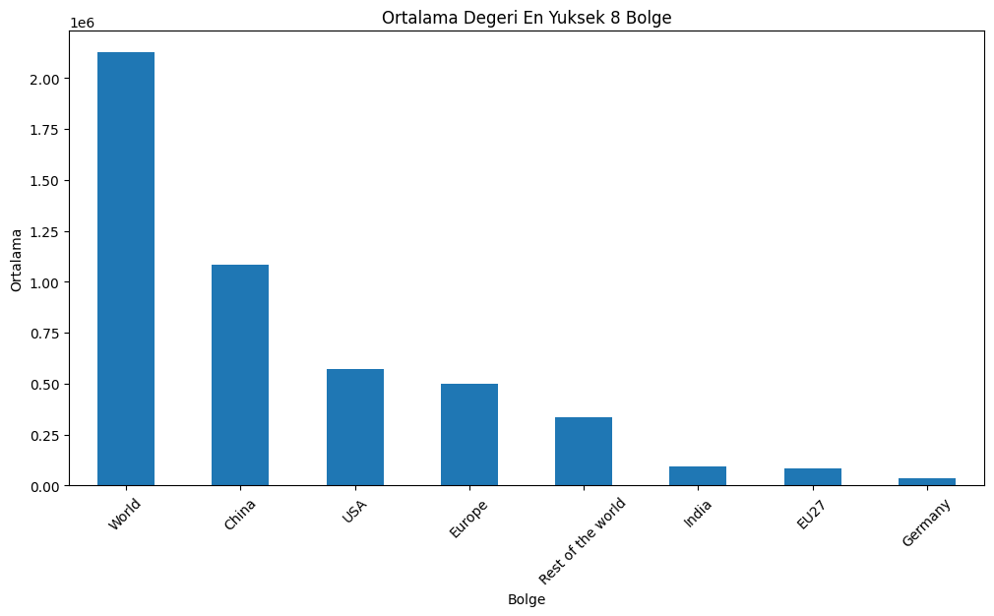

Slide 15
Conclusion
Each type of electric vehicle has its own benefits and meets different needs. Battery Electric Vehicles (BEVs) produce no emissions and cost less to run but need charging stations. Fuel Cell Electric Vehicles (FCEVs) can refuel quickly and go long distances, but they face challenges with fueling stations and production. Plug-in Hybrid Electric Vehicles (PHEVs) offer flexibility and lower emissions, but they are more complicated and still use gas for longer trips. Knowing about these options helps people choose the right vehicle based on how they drive and their environmental goals.

Slide 16
References
kaggle
Github
sklearn,numpy,matplotlib,pandas,seaborn documentation
youtube

